Slide 1



Financial Analysis Dashboard
View in Power BI
Last data refresh:
24/12/2025 16:07:03 UTC
Downloaded at:
24/12/2025 16:12:44 UTC

Slide 2
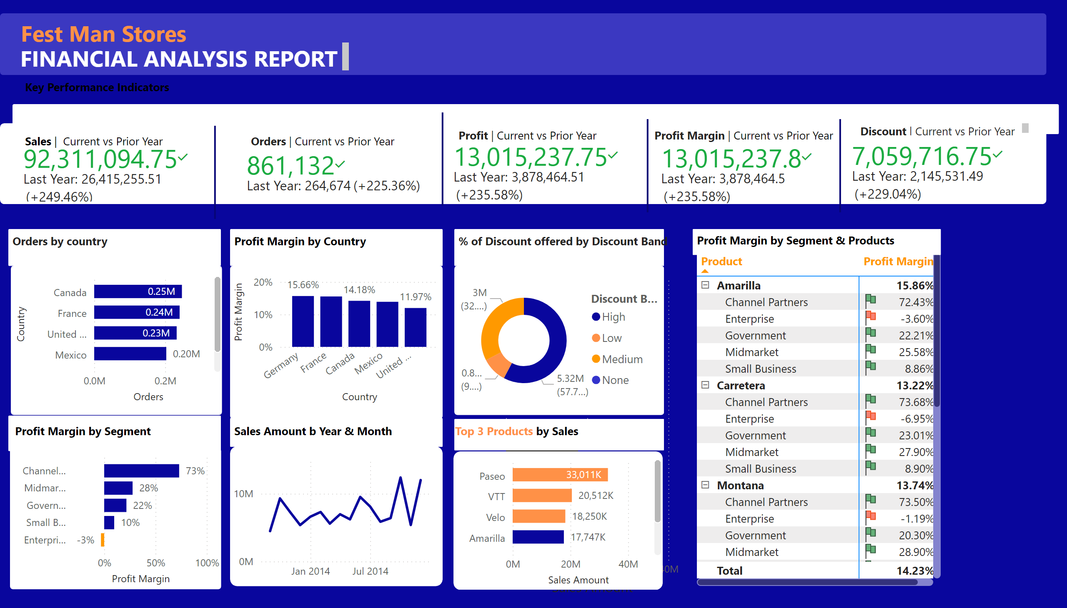
Financial Dashboard
Notes:
shape
No alt text provided
shape
No alt text provided
shape
No alt text provided
shape
No alt text provided
shape
No alt text provided
shape
No alt text provided
shape
No alt text provided
shape
No alt text provided
shape
No alt text provided
shape
No alt text provided
shape
No alt text provided
shape
No alt text provided
shape
No alt text provided
shape
No alt text provided
shape
No alt text provided
shape
No alt text provided
textbox
No alt text provided
textbox
No alt text provided
textbox
No alt text provided
textbox
No alt text provided
kpi
No alt text provided
textbox
No alt text provided
shape
No alt text provided
kpi
No alt text provided
kpi
No alt text provided
kpi
No alt text provided
kpi
No alt text provided
textbox
No alt text provided
shape
No alt text provided
shape
No alt text provided
shape
No alt text provided
textbox
No alt text provided
textbox
No alt text provided
textbox
No alt text provided
textbox
No alt text provided
barChart
No alt text provided
textbox
No alt text provided
columnChart
No alt text provided
textbox
No alt text provided
donutChart
No alt text provided
donutChart
No alt text provided
barChart
No alt text provided
lineChart
No alt text provided
barChart
No alt text provided
textbox
No alt text provided
textbox
No alt text provided
textbox
No alt text provided
pivotTable
No alt text provided
barChart
No alt text provided
textbox
No alt text provided
textbox
No alt text provided

